Slide 1
2016 president election prediction using twitter data
Weifeng Li

Slide 2
Introduction
Data selection.
Building a complete data Ming System.
Naïve Bayes algorithm and Support vector machine Model(SVM).
Parameter tunning and Model evaluation.
Visualization (Excel, Python graphing Library ,Word Cloud.)

Slide 3
DataSet
Data | Description | Format | Size | source
Twitter | Tweeter data related to 2016 presidential election | JSON | 100,000 | Using tweeter API(tweepy)
Twitter analysis | Twitter Sentiment Analysis results | .csv | 13,871 | https://www.kaggle.com/crowdflower/first-gop-debate-twitter-sentiment

Slide 4
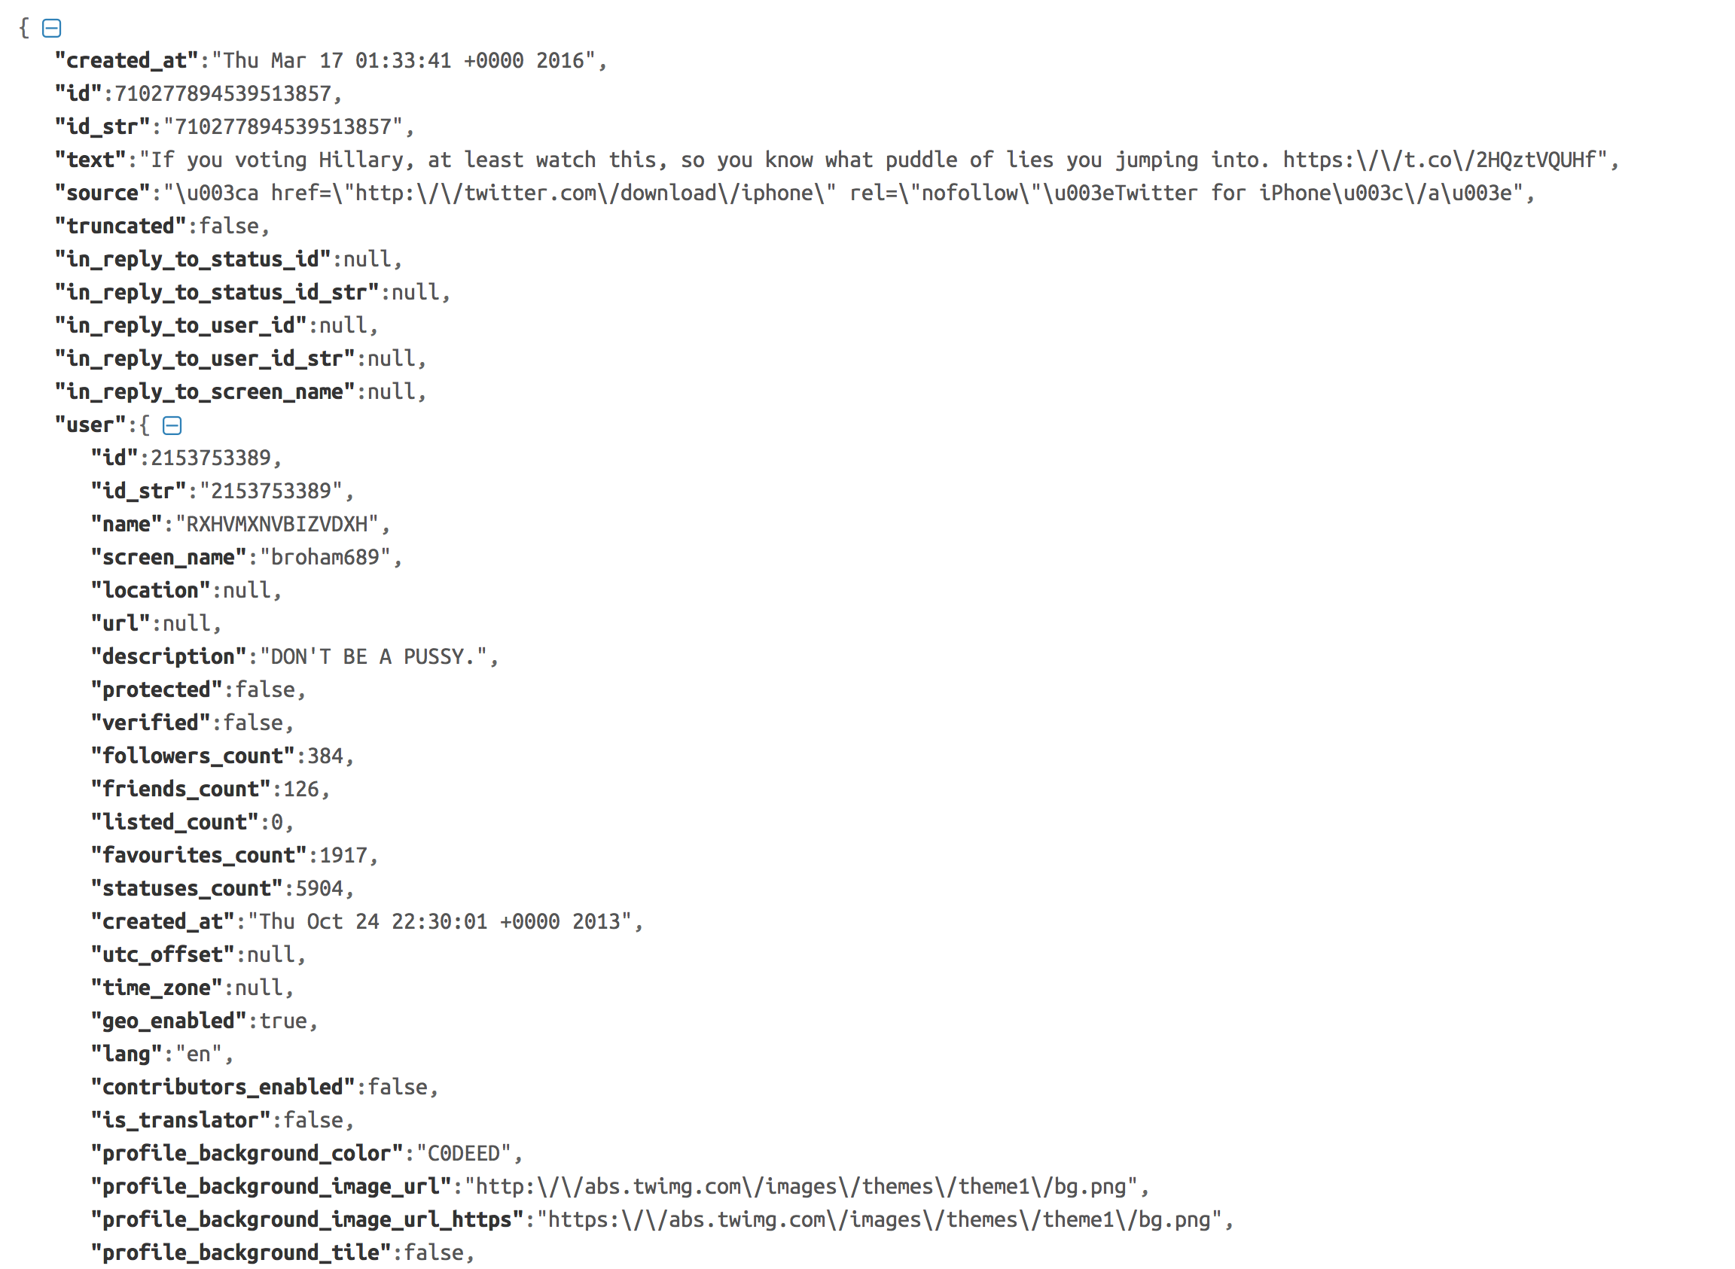
Sample data(twitter)
Notes:
Our goal is to process the datasets extracting the most important information from them and then draw the relationships between happening of crimes and these factors.

Slide 5
Sample data(twitter)
Id | candidate | text | Time | Place
710277894539513857 | Hilary Clinton | RT @NancyLeeGrahn: How did everyone feel about the Climate Change question last night? Exactly. #GOPDebate | Thu Mar 17 01:33:41 +0000 2016 | "Atlanta, GA"
710277896791859200 | Donald Trump | RT @DanScavino: #GOPDebate w/ @realDonaldTrump delivered the highest ratings in the history of presidential debates. #Trump2016 http://t.coâ€¦ | Thu Mar 17 01:33:41 +0000 2016 | "Atlanta, GA"

Slide 6
Sample data(Kaggle)
Id | candidate | text | sentiment | confident
710277894539513857 | No candidate mentioned | RT @NancyLeeGrahn: How did everyone feel about the Climate Change question last night? Exactly. #GOPDebate | Neutral | 0.6578
710277894539513857 | Donald Trump | RT @DanScavino: #GOPDebate w/ @realDonaldTrump delivered the highest ratings in the history of presidential debates. #Trump2016 http://t.coâ€¦ | Positive | 0.7045

Slide 7
Problem Definition
Firstly, using sentimental analysis, based on the twitter data, the popularities of each candidate will be come up with. In this phase, two algorithms Naïve Bayes and SVM will be used as the classifier and performance of them will be evaluated at the end.
Secondly, I will do the parameter tuning for the algorithms to find the best parameters for each algorithm.
Third, I will evaluate the performance of each algorithm. To do this, Confusion Matrix was used here .
Besides, I will use Latent Dirichlet allocation(LDA) model extracting frequent topics related to 2016 presidential election using twitter data set. For better illustration of the results, I will visualize the results in World Cloud.

Slide 8
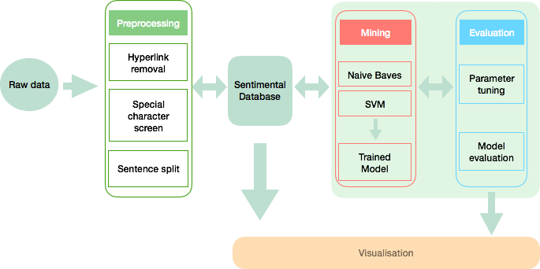
Design & Implementation

Slide 9
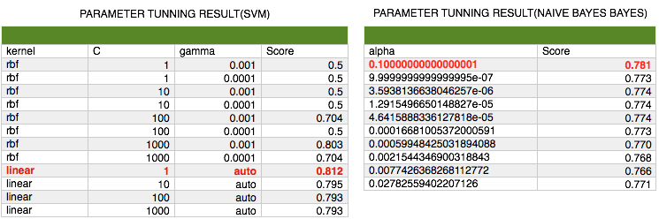
Parameter tuning
Notes:
To find the best parameters for these classification algorithms, I used cross-validation method for the parameter tuning. As can be seen below, throw this way, the best kernel parameter for SVM and the best alpha parameter for Naïve Bayes were found.

Slide 10
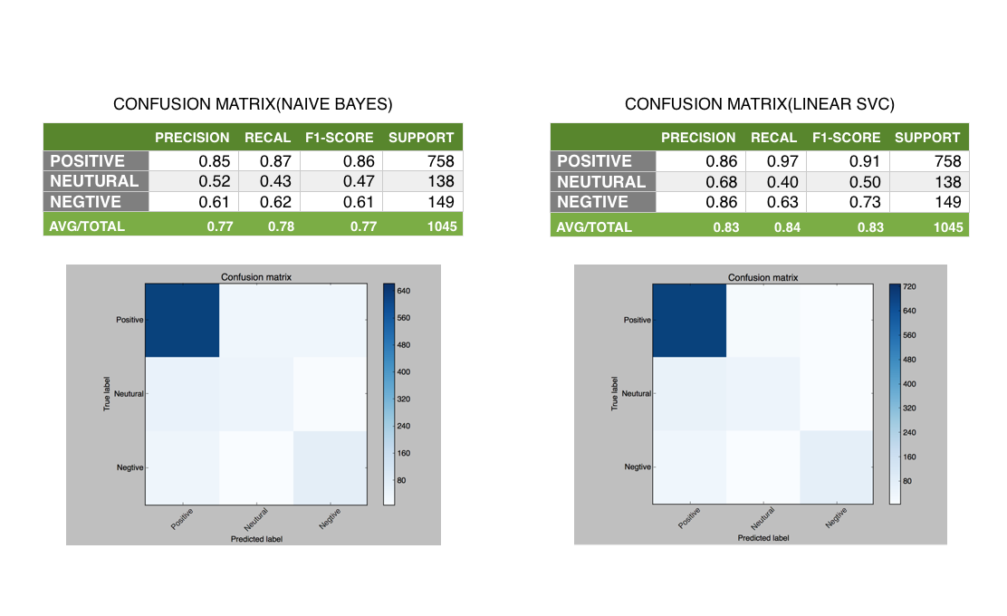
Model Evaluation
Notes:
To evaluate the accurate performance, Confusion Matrix was used here. As shown below, the accuracy of Linear SVC classifier was better than Naïve Bayes.

Slide 11
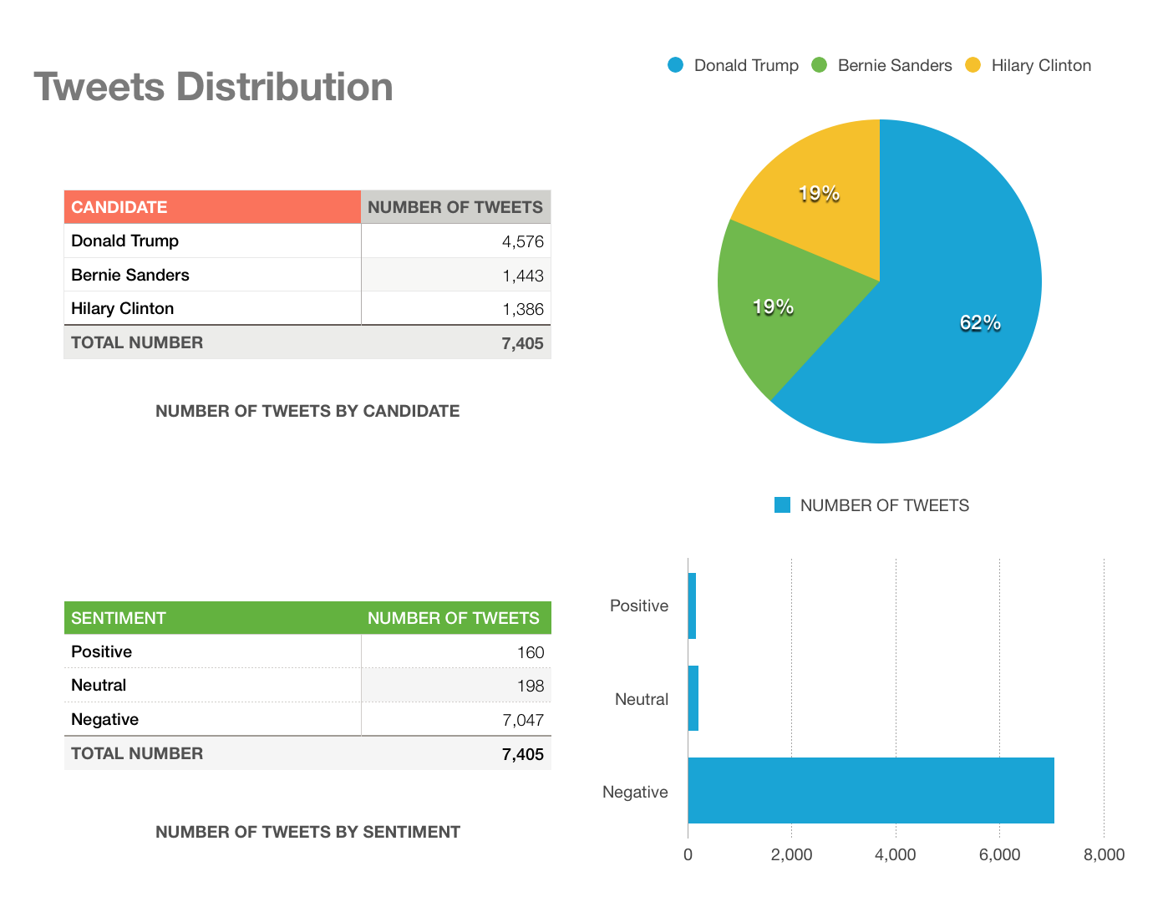
Results(1)
Notes:
We can see that several interesting things from the result. Firstly, the overwhelming number of tweets are Negatives. Secondly, Donald Trump was more popular than the other candidates. Last, although Trump was more popular, Hilary was more possible win the election.

Slide 12
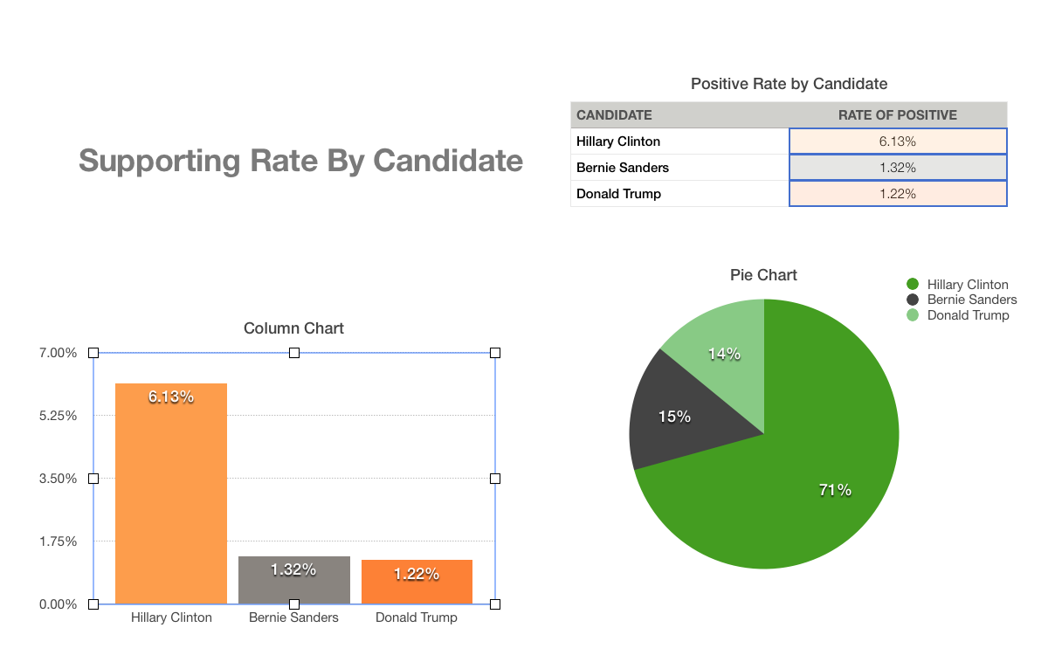
Results(2)

Slide 13
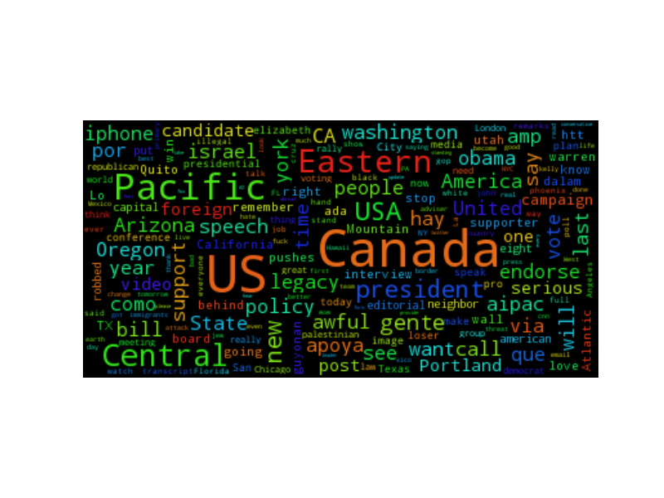
Results(3)

Slide 14
Conclusion & Future work
Designed and implemented a complete data-mining system.
Getting familiar with the process of data-mining especially sentimental data-mining using twitter data.
Getting familiar with several classification algorithms and related parameter tuning and model evaluation methods.
Give me some instructions for future work.

Slide 15
Thank you

